Slide 1
19CSE305 MACHINE LEARNING Lecture 4_P1

Slide 2
Agenda
Getting to Know Your Data

Slide 3
Getting to Know Your Data
Types of Data Sets
Important Characteristics of Structured Data
Data Objects and Attribute Types
Basic Statistical Descriptions of Data

Slide 4
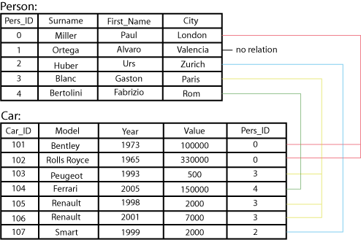
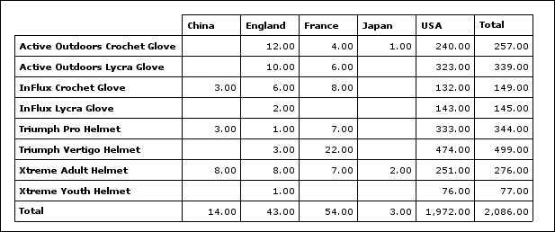
Types of Data Sets: (1) Record Data
Relational records
Relational tables, highly structured
Data matrix, e.g.numerical matrix, crosstabs
Transaction data
Document data: Term-frequency vector (matrix) of text documents

Slide 5
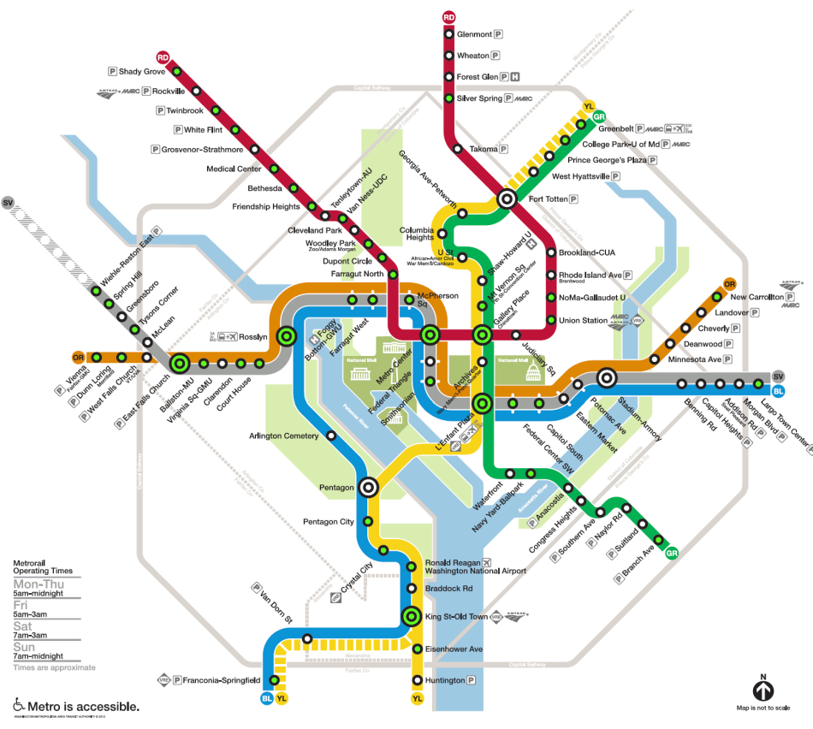

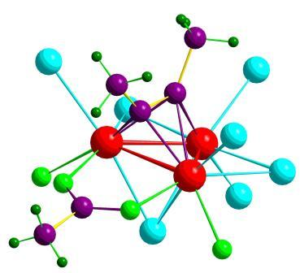

Types of Data Sets: (2) Graphs and Networks
Transportation network
World Wide Web
Molecular Structures
Social or information networks

Slide 6
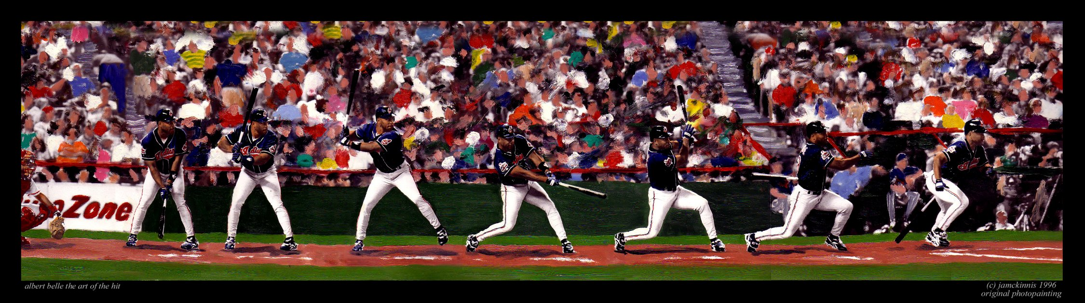
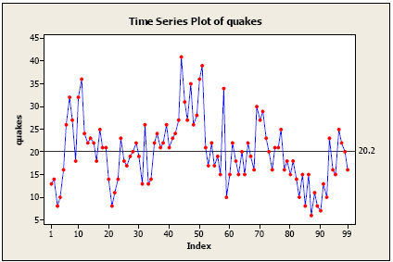
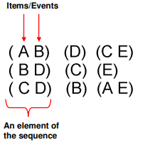
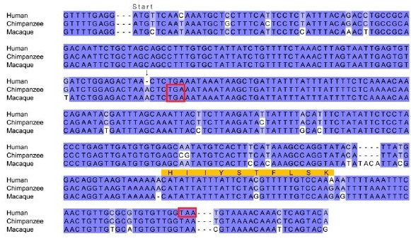
Types of Data Sets: (3) Ordered Data
Video data: sequence of images
Temporal data: time-series: For example, a financial data set might contain objects that are time series of the daily prices of various stocks.
Sequential Data: transaction sequences -Time
Genetic sequence data (Position) : the genetic information of plants and animals can be represented in the form of sequences of nucleotides that are known as genes.

Slide 7
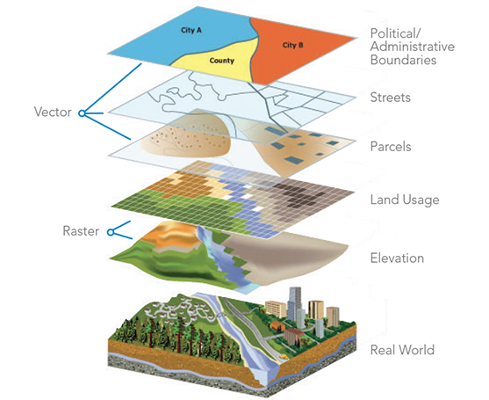
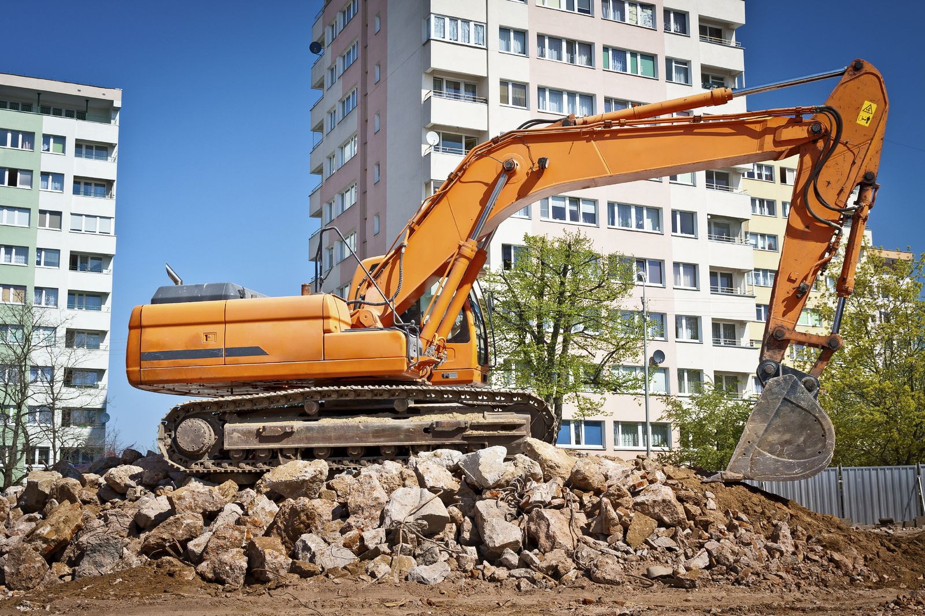
Types of Data Sets: (4) Spatial, image and multimedia Data
Spatial data: . An example of spatial data is weather data (precipitation, temperature, pressure) that is collected for a variety of geographical locations.
Image data:
Video data:

Slide 8
Important Characteristics of Structured Data
Dimensionality
Curse of dimensionality
Sparsity
Only presence counts
Resolution
Patterns depend on the scale
Distribution
Centrality and dispersion

Slide 9
Data Objects
Data sets are made up of data objects
A data object represents an entity
Examples:
sales database: customers, store items, sales
medical database: patients, treatments
university database: students, professors, courses
Also called samples , examples, instances, data points, objects, tuples
Data objects are described by attributes
Database rows → data objects; columns → attributes

Slide 10
What is dataset?
Collection of data objects and their attributes
An attribute is a property or characteristic of an object
Examples: eye color of a person, temperature, etc.
Attribute is also known as variable, field, characteristic, or feature
A collection of attributes describe an object
Object is also known as record, point, case, sample, entity, or instance

Slide 11
Attribute value
Attribute values are numbers or symbols assigned to an attribute
Distinction between attributes and attribute values
Same attribute can be mapped to different attribute values
Example: height can be measured in feet or meters
Different attributes can be mapped to the same set of values
Example: Attribute values for ID and age are integers
But properties of attribute values can be different
ID has no limit but age has a maximum and minimum value

Slide 12
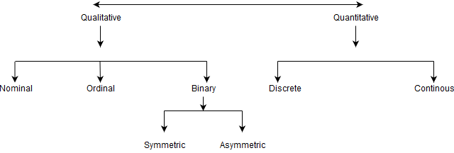
Attributes

Slide 13
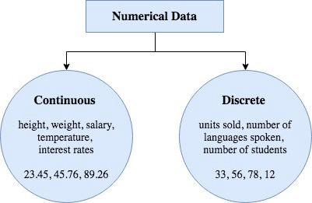
Discrete vs. Continuous Attributes
Discrete Attribute – take only certain data
Has only a finite or countably infinite set of values
E.g., zip codes, profession, or the set of words in a
collection of documents
Sometimes, represented as integer variables
Note: Binary attributes are a special case of discrete attributes
Continuous Attribute- any value
Has real numbers as attribute values
E.g., temperature, height, or weight
Practically, real values can only be measured and represented using a finite number of digits
Continuous attributes are typically represented as floating-point variables

Slide 14
Attributes
Attribute (or dimensions, features, variables)
A data field, representing a characteristic or feature of a data object.
E.g., customer _ID, name, address
Types:
Nominal (e.g., red, blue)
Binary (e.g., {true, false})
Ordinal (e.g., {freshman, sophomore, junior, senior})
Numeric: quantitative
Interval-scaled: 100○C is interval scales
Ratio-scaled: 100○K is ratio scaled since it is twice as high as 50 ○K
Q1: Is student ID a nominal, ordinal, or interval-scaled data?
Q2: What about eye color? Or color in the color spectrum of physics?

Slide 15
Attribute Types - Qualitative
Nominal: categories, states, or “names of things”- Assign numbers to objects
Hair_color = {auburn, black, blond, brown, grey, red, white}
marital status, occupation, ID numbers, zip codes (Simply to differentiate between object)
Binary
Nominal attribute with only 2 states (0 and 1)
Symmetric binary: both outcomes equally important
e.g., gender
Asymmetric binary: outcomes not equally important.
e.g., medical test (positive vs. negative)
Convention: assign 1 to most important outcome (e.g., HIV positive)
Ordinal- Assign numbers to objects – meaningful order
Values have a meaningful order (ranking) but magnitude between successive values is not known
Size = {small, medium, large}, grades, army rankings

Slide 16
Attribute Types - Quantitative
Quantity (integer or real-valued)
Interval – Numbers have order but there are also equal interval between adjacent categories
Measured on a scale of equal-sized units- 78 degree and 79 degree, 48 degree and 49 degree
Values have order
E.g., temperature in C˚or F˚, calendar dates
No true zero-point
Ratio- differences are meaningful +ratios are meaningful + true zero points
Inherent zero-point
We can speak of values as being an order of magnitude larger than the unit of measurement (10 K˚ is twice as high as 5 K˚).
e.g., temperature in Kelvin (Zero means no temperature), length, counts, monetary quantities

Slide 17
Difference Between Ratio and Interval
Is it physically meaningful to say that a temperature of 10 ° is twice that of 5° on
the Celsius scale?
the Fahrenheit scale?
the Kelvin scale?
5 degrees Celsius = 41 degrees Fahrenheit
10 degrees Celsius = 50 degrees Fahrenheit
The reason is that zero degrees Celsius is not the bottom of the scale. The coldest possible temperature, or absolute zero, is -273.15 degrees Celsius, or 0 degrees Kelvin.
Consider measuring the height above average
If Bill’s height is three inches above average and Bob’s height is six inches above average, then would we say that Bob is twice as tall as Bill?
Is this situation analogous to that of temperature?

Slide 18
Difference Between Interval and ordinal
Temperature: a 1 degree difference is the same at all point of the scale (Interval)
Place in race (1st, 2nd ,3rd ): The difference in finishing between 1st and 2nd is not necessarily (and probably not) the same as the difference between 2nd and 3rd (ordinal).
Difference Between Ratio and Interval
Temperature: 0 degrees does not mean an absence of the property ( no true zero point) and 80 degrees is not twice as hot as 40 degrees (interval).

Slide 19
Properties of Attribute Values
The type of an attribute depends on which of the following properties it possesses:
Distinctness =
Order < >
Addition + -
Multiplication * /
Nominal attribute: distinctness
Order attribute: distinctness & order
Interval attribute: distinctness, order & addition
Ratio attribute: all 4 properties

Slide 20
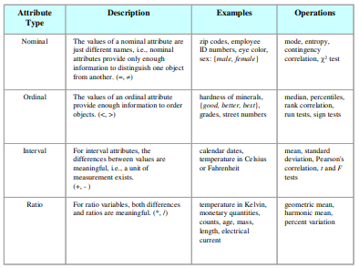

Slide 21
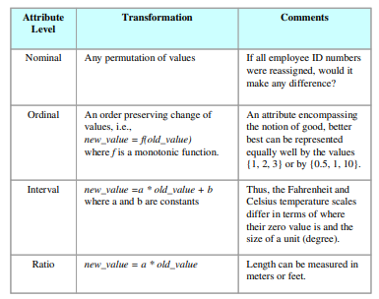

Slide 22
Attributes
Attribute | Nominal | Ordinal | Interval | Ratio
Name2 | Categorical | Sequence | Equal interval | Ratio
Name3 | Set | Fully ordered, rank ordered | Unit size fixed | Zero or ref.pt fixed
Statistics | Count, Mode, chi-squared | + median, rank order correlation | + ANOVA, mean, STDev | + logs??
Example1 | Set of participants, makes of car | order of finishing a race | centigrade scale | Degrees Kelvin or absolute
Transformations/ rescaling allowed | Rename | Montonic (any curve that always increases) | Linear | -
Transformations 2 | Hash function | Montonic | Add and multiply | multiply?
Transformation examples | 1:1 mapping, Assign colours for lines on a chart | Sorting. Log or exp | Z-transform, renormalise IQ scores | Scale (zoom in or out)
Types of relativity | A≠B | A>B | |(A-B)| > |(C-D)| | ?
Types of absolute | Identity of individual entities | order, seqeuence | intervals, differences | ratios, proportions

Slide 23
Attributes
Nominal | Just names, IDs
Ordinal | Have / represent rank order (e.g. fully agree, mostly agree, somewhat agree)
Interval | Has a fixed size of interval between data points. (E.g. degrees Centigrade)
Ratio | Has a true zero point (e.g. mass, length)

Slide 24
Key Messages for Attribute Types
The types of operations you choose should be “meaningful” for the type of data you have
Distinctness, order, meaningful intervals, and meaningful ratios are only four (among many possible) properties of data
The data type you see – often numbers or strings – may not capture all the properties or may suggest properties that are not present
Analysis may depend on these other properties of the data
Many statistical analyses depend only on the distribution
In the end, what is meaningful can be specific to domain

Slide 25
19CSE305 MACHINE LEARNING Lecture 4_P2
Basic Statistical Descriptions of Data

Slide 26
Types of statistics
Descriptive
Describe the data- simple summaries
Data Analysis
Analyze the previous year sales data to find interesting insight
Invest made by the company
Profit % etc
Use numerical measures
Inferential
Get inference about the data
Data Science
Use data to find several insights/inferences
Suggest the company about certain strategies to increase their profit

Slide 27
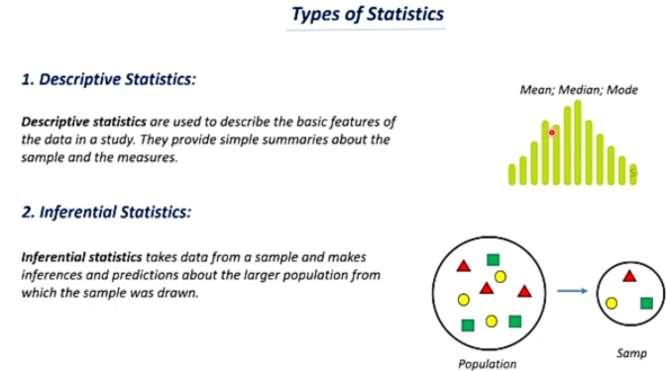
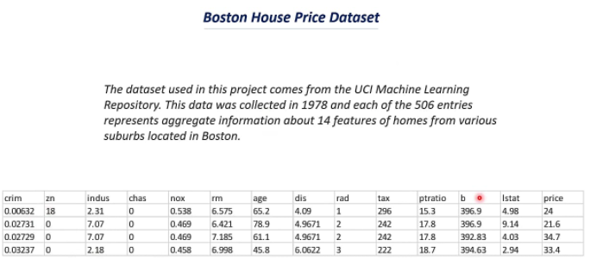
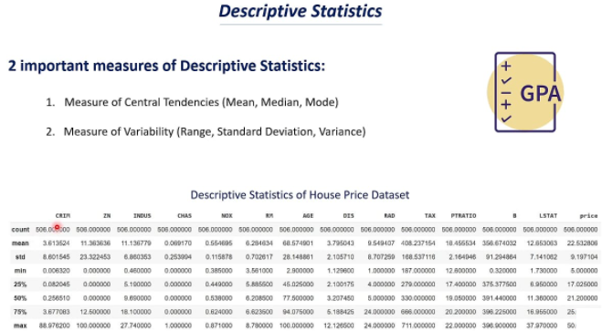

Slide 28
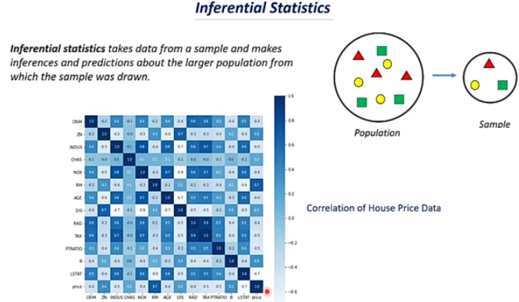

Slide 29
Basic Statistical Descriptions of Data
It is a science concerned with developing and studying models for collecting, analysing, interpreting and presenting data
Why- To extract information and knowledge
To get overall picture of the data, basic Statistical Descriptions are used in data Analysis
Statistical metrics can tell us if there are issues exist as extreme outliers and large deviation in the values of attributes
Outliers:
Data values differs significantly from other values
It affects the mean value of the data but little effect on median and mode.
Who is the best batsman in the world in the time period 2010 to 2020?
Batting strike rate (s/r) is defined for a batsman as the average number of runs scored per 100 balls faced. The higher the strike rate, the more effective a batsman is at scoring quickly.

Slide 30
Basic Statistical Descriptions of Data
What
Measure of central tendency
Mean, Median and mode
Location of the centre of a data distribution
Where do most of the attribute values fall?
Dispersion Measure
Range, quartiles, inter quartile range, five number summary and box plots , variance and standard deviation
It describes how are the data spread out.

Slide 31
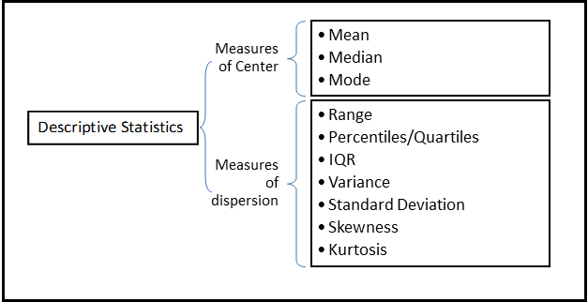
Descriptive Statistics

Slide 32
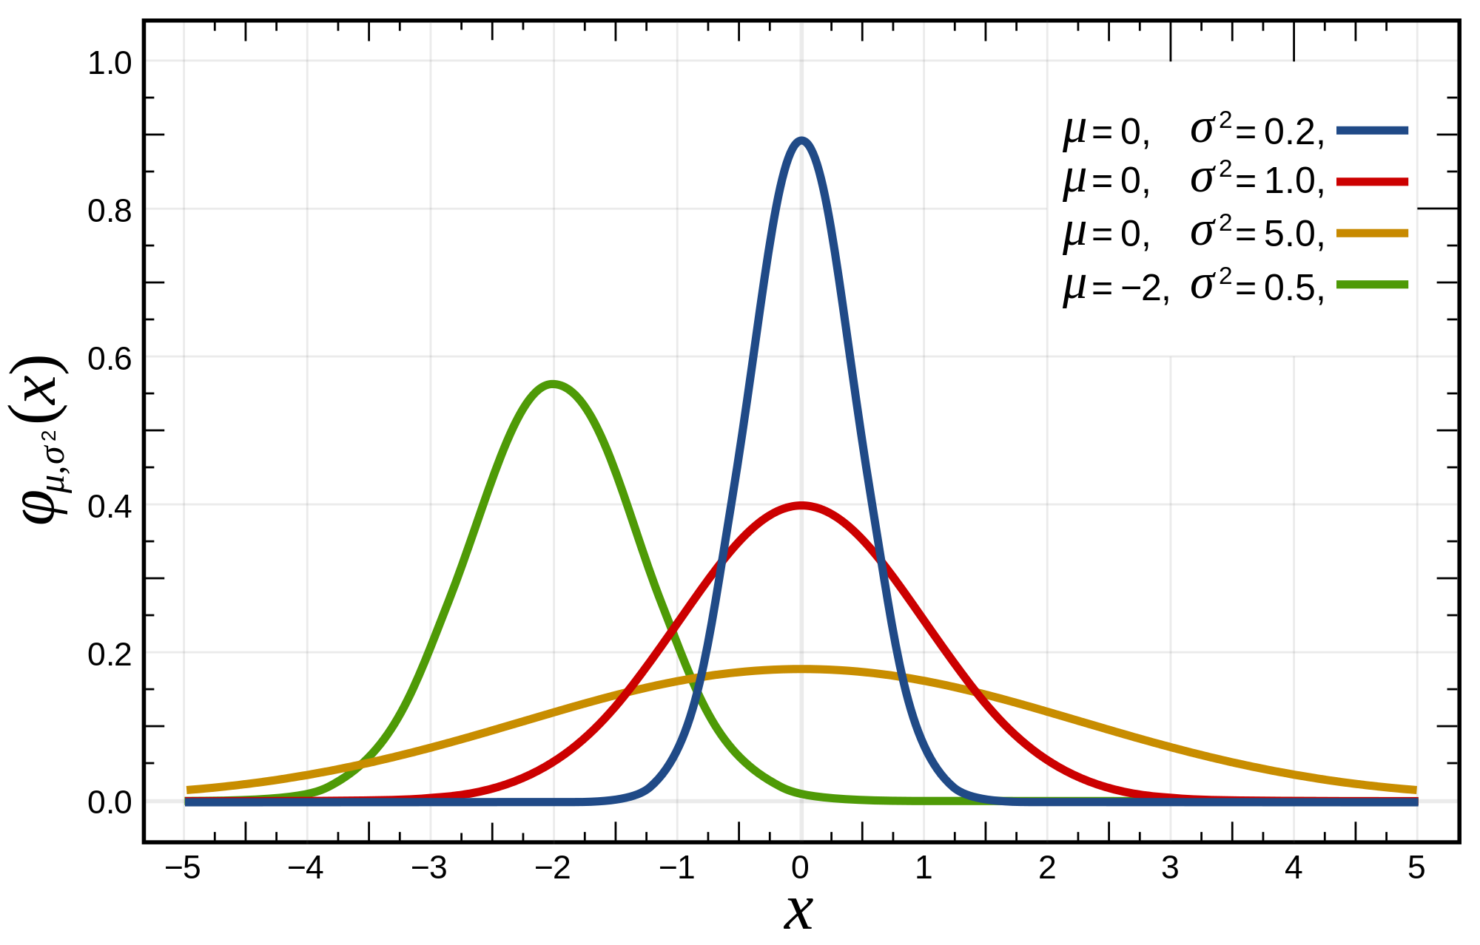
Basic Statistical Descriptions of Data
Motivation
To better understand the data: central tendency, variation and spread
Data dispersion characteristics
Median, max, min, quantiles, outliers, variance, ...
Numerical dimensions correspond to sorted intervals
Data dispersion:
Analyzed with multiple granularities of precision
Boxplot or quantile analysis on sorted intervals
Dispersion analysis on computed measures
Folding measures into numerical dimensions
Boxplot or quantile analysis on the transformed cube
Notes:
Note to self (MK): last part of slide does not clearly match slides that follow
Introduction slides:
In the current version, we only talk about numeric data. Can we add some materials about non-numeric data.
- text statistics, TF/IDF
- visualization of text statistics such as word cloud
- distribution of Internet (IN, SCC, OUT, …)
- visualization of social relationship (e.g., http://renlifang.msra.cn/)

Slide 33
Measuring the Central Tendency: (1) Mean
Mean (algebraic measure) (sample vs. population):
Note: n is sample size and N is population size.
Weighted arithmetic mean:
Trimmed mean:
Chopping extreme values (e.g., Olympics gymnastics score computation)

Slide 34
Measuring the Central Tendency: (1) Mean
Suppose we have the following values for salary(in thousands of dollars), shown in increasing order:
30, 31, 47, 50, 52, 52, 56, 60, 63, 70, 70
Estimated Mean = (30+31+47+50+52+52+56+60+63+70+70)/11
= 581/11
= 52.81

Slide 35
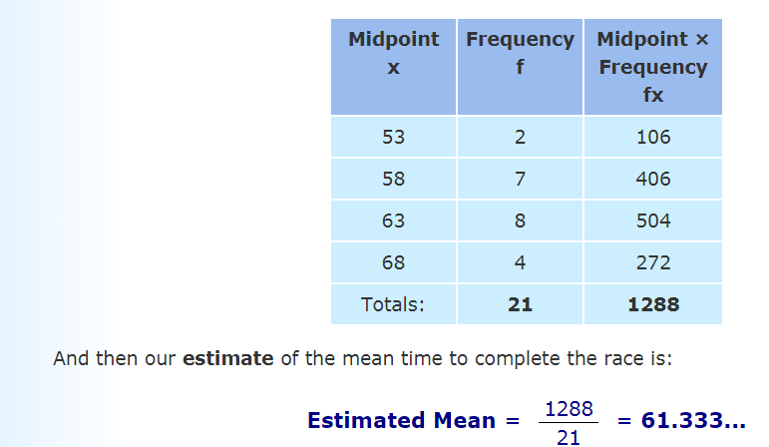
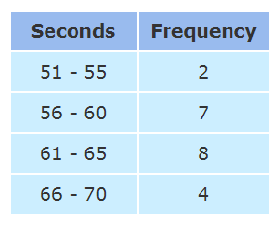
Measuring the Central Tendency: (1) Mean
Compute the mean of the following grouped data:

Slide 36
Measuring the Central Tendency: (1) Mean
A dice was rolled 20 times. On each roll the dice shows a value from 1 to 6. The results have been recorded in the table below:
As a list 1, 1, 1, 2, 2, 2, 2, 2, 3, 3, 4, 4, 4, 4, 5, 5, 5, 6, 6, 6
A frequency table is a shorthand representation of list of data.
Value | Frequency
1 | 3
2 | 5
3 | 2
4 | 4
5 | 3
6 | 3
Value | Frequency | Value × Frequency
1 | 3 | 1 × 3 = 3
2 | 5 | 2 × 5 = 10
3 | 2 | 3 × 2 = 6
4 | 4 | 4 × 4 = 16
5 | 3 | 5 × 3 = 15
6 | 3 | 6 × 3 = 18
Totals | 20 | 68
Estimated mean = 68 / 20 = 3.4

Slide 37
Measuring the Central Tendency: (1) Mean
Example 2 : Several seaside hotels were rated between "no stars" and "five stars" by the tourist board.
The table below shows how many hotels got each number of stars.
Work out the mean number of stars by filling in the gaps in the table below.
Stars | Frequency | Stars × Frequency
0 | 2
1 | 6
2 | 8
3 | 3
4 | 0
5 | 1

Slide 38
Measuring the Central Tendency: (1) Mean
Example 3 Professor Baker keeps a record of his golf scores, as shown in the table below:
Score | Frequency
70 | 3
71 | 4
72 | 4
73 | 4
74 | 3
75 | 2

Slide 39
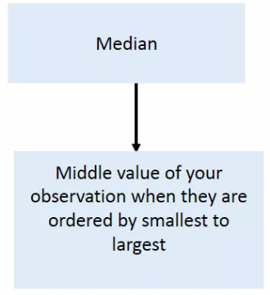
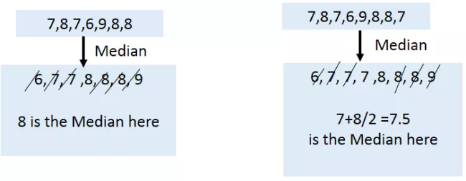
Measuring the Central Tendency: (2) Median
Median
Median is nothing more than the middle value of your observations when they are order from the smallest to the largest.
It involves two steps:
Oder your cases from smallest to largest
Find the middle Value

Slide 40
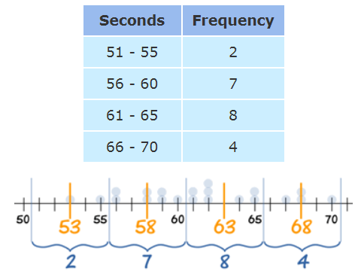
Measuring the Central Tendency: (2) Median
Median:
Middle value if odd number of values, or average of the middle two values otherwise
Estimated by interpolation (for grouped data):
Estimated Median = L + (n/2) − B × w
------------
G
where:
L is the lower class boundary of the group containing the median
n is the total number of values
B is the cumulative frequency of the groups before the median group
G is the frequency of the median group
w is the group width- Upper and lower class boundaries of median class

Slide 41
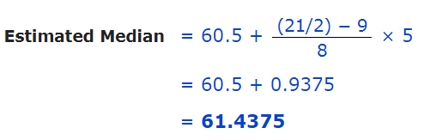
Measuring the Central Tendency: (2) Median
For our example:
The median is the middle value, which in our case is the 11th one, which is in the 61 - 65 group:
We can say "the median group is 61 - 65“
L = 60.5
n = 21
B = 2 + 7 = 9
G = 8
w = 5

Slide 42
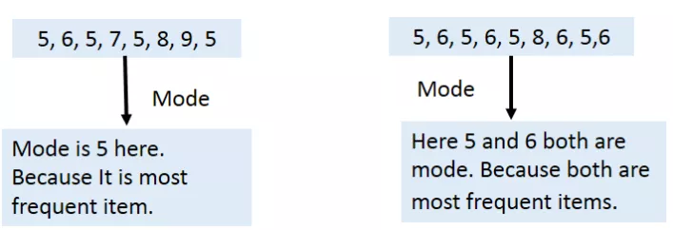
Measuring the Central Tendency: (3) Mode
Mode
Value that occurs most frequently in the data
Unimodal, bimodal, multimodal

Slide 43
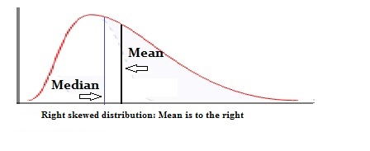
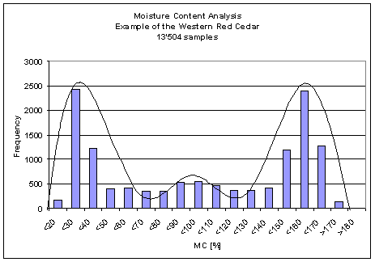
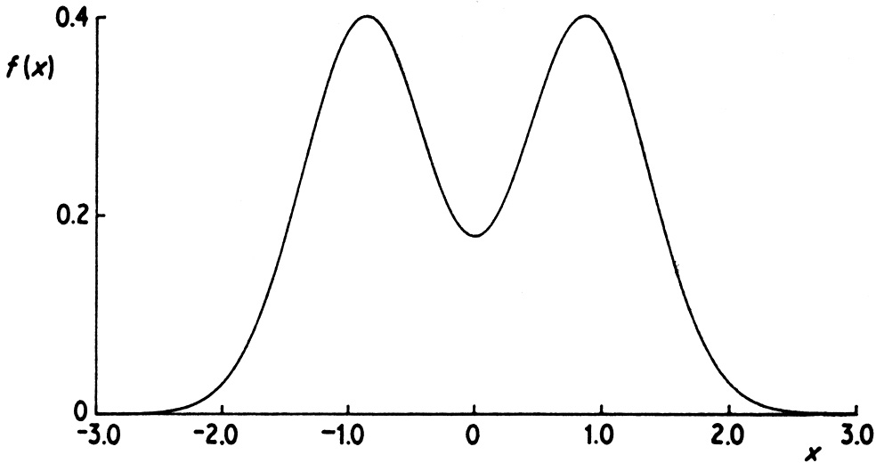
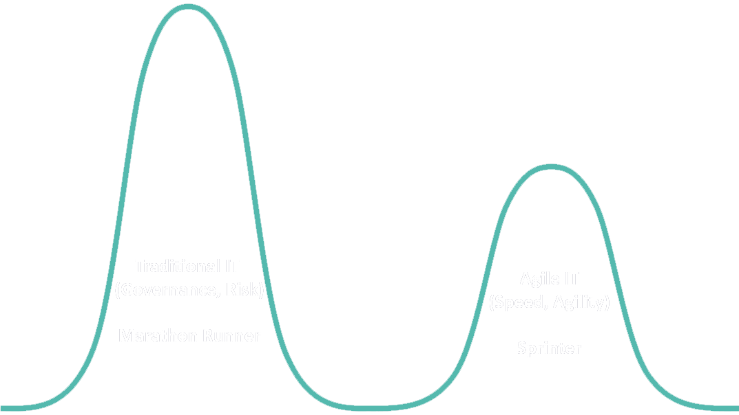
Measuring the Central Tendency: (3) Mode
Mode: Value that occurs most frequently in the data
Unimodal
Empirical formula:
Multi-modal
Bimodal
Trimodal

Slide 44
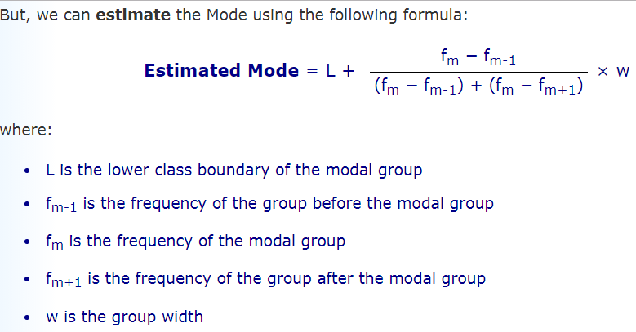
Measuring the Central Tendency: (3) Mode
Mode for the grouped data:

Slide 45
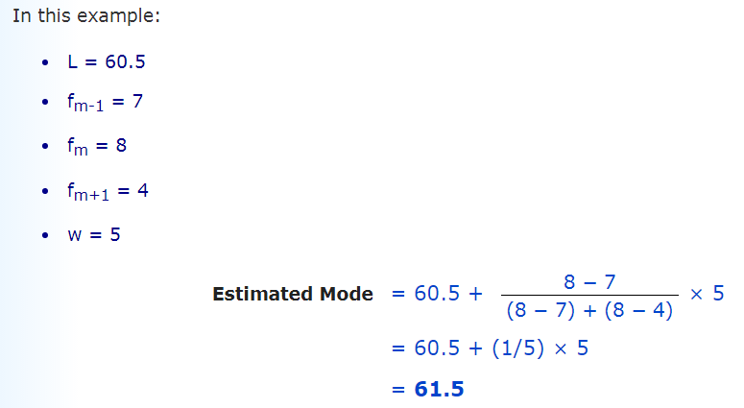
Compute the mode of the grouped data

Slide 46
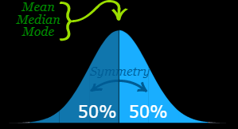
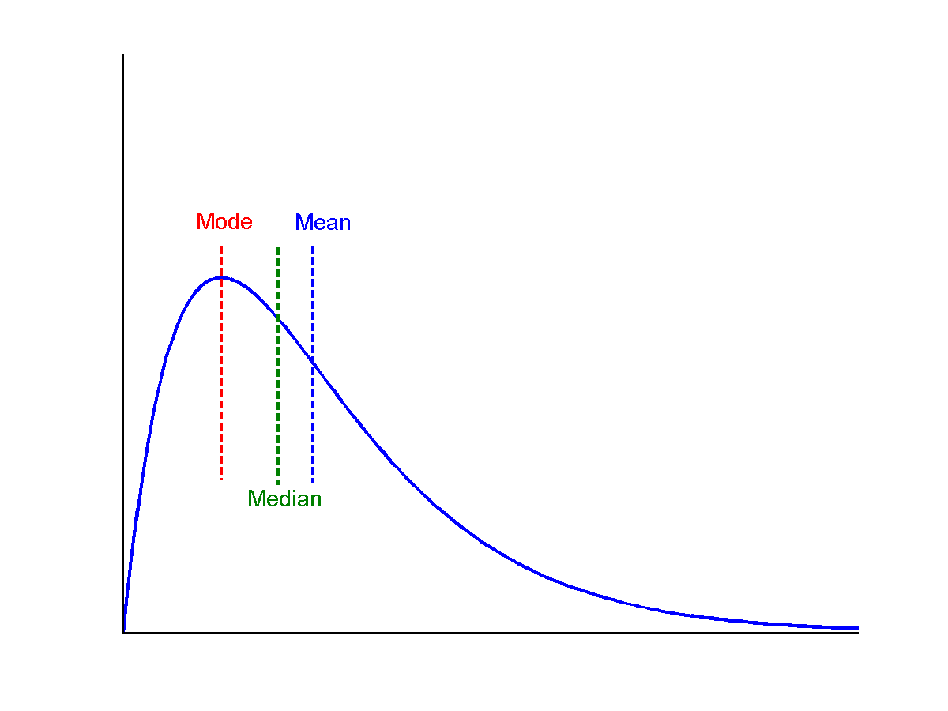
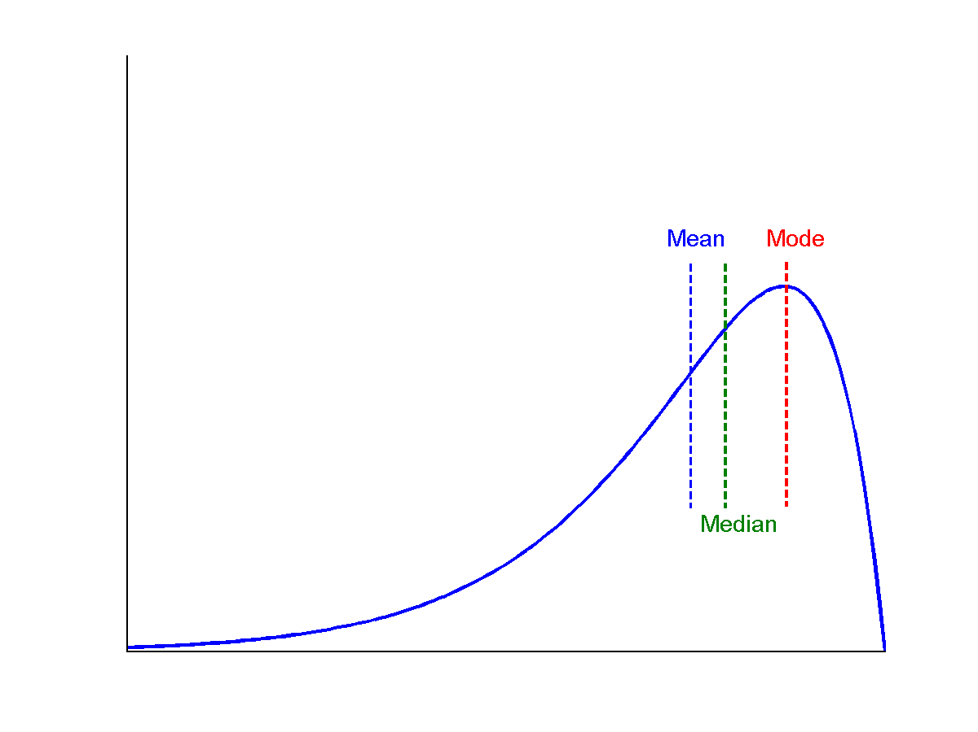
Symmetric vs. Skewed Data
Symmetric/No Skew
Data can be "skewed", meaning it tends to have a long tail on one side or the other:
Median, mean and mode of symmetric, positively and negatively skewed data
negatively skewed or left skewed
positively skewed or Right skewed

Slide 47
When to use what measurement of central tendency ??
If data is Categorical (Nominal or Ordinal) it is impossible to calculate mean or median. So, go for mode.
If your data is quantitative then go for mean or median.
Basically, if your data is having some influential outliers (190, 192, 345) or data is highly skewed then median is the best measurement for finding central tendency. Otherwise go for Mean

Slide 48
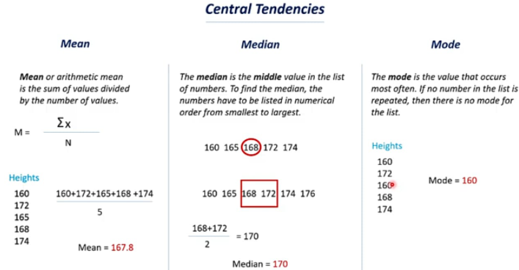

Slide 49
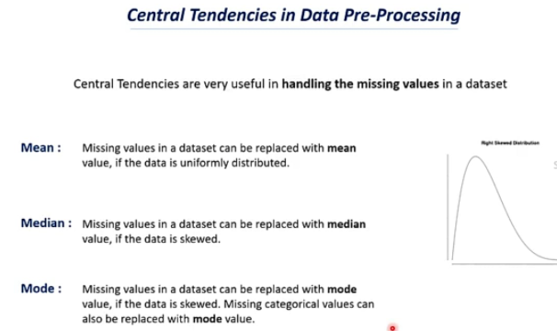

Slide 50
Practice Questions: Mean
the grade 10 math class recently had a mathematics test and the grades were as follows: 78 66 82 89 75 74 Mean= 464 / 6 = 77.3

Slide 51
Practice Questions: Mean
The following table shows the number of plants in 20 houses in a group . Find the mean number of plans per house
Number of Plants | 0 - 2 | 2 - 4 | 4 - 6 | 6 - 8 | 8 - 10 | 10 - 12 | 12 - 14
Number of Houses | 1 | 2 | 2 | 4 | 6 | 2 | 3

Slide 52
Practice Questions: Mean
The following table shows the number of plants in 20 houses in a group . Find the mean number of plans per house
Number of Plants | 0 - 2 | 2 - 4 | 4 - 6 | 6 - 8 | 8 - 10 | 10 - 12 | 12 - 14
Number of Houses | 1 | 2 | 2 | 4 | 6 | 2 | 3
Number of Plant | Number of Houses (f_{i}) | Class Mark (x_{i}) | f_{i}x_{i}
0 - 2 | 1 | 1 | 1 × 1 = 1
2 - 4 | 2 | 3 | 2 × 3 = 6
4 - 6 | 2 | 5 | 2 × 5 = 10
6 - 8 | 4 | 7 | 4 × 7 = 28
8 - 10 | 6 | 9 | 6 × 9 = 54
10 - 12 | 2 | 11 | 2 × 11 = 22
12 -14 | 3 | 13 | 3 × 13 = 39

Slide 53
Practice Questions: Mean
The following table shows the number of plants in 20 houses in a group. Find the mean number of plans per house
Number of Plant | Number of Houses (f_{i}) | Class Mark (x_{i}) | f_{i}x_{i}
0 - 2 | 1 | 1 | 1 × 1 = 1
2 - 4 | 2 | 3 | 2 × 3 = 6
4 - 6 | 2 | 5 | 2 × 5 = 10
6 - 8 | 4 | 7 | 4 × 7 = 28
8 - 10 | 6 | 9 | 6 × 9 = 54
10 - 12 | 2 | 11 | 2 × 11 = 22
12 -14 | 3 | 13 | 3 × 13 = 39
∑f_{i} = 1 + 2 + 2 + 4 + 6 + 2 + 3 = 20 ∑f_{i} x_{i} =1 + 6 + 10 + 28 + 54 + 22 + 39 = 160 Therefore, mean = ∑(f_{i}x_{i})/ ∑f_{i} = 160/20 = 8 plants

Slide 54
Practice Questions: Median
the grade 10 math class recently had a mathematics test and the grades were as follows: 78 66 82 89 75 74
Arrange in order 66 74 75 78 82 89
75 + 78 = 153
Median = 153 / 2 = 76.5

Slide 55
Practice Questions: Mode
Find the mode of the following data:
78 56 68 92 84 76 74 56 68 66 78 72 66 65 53 61 62 78 84 61 90 87 77 62 88 81

Slide 56
Mode
Find the mode of the following data:
78 56 68 92 84 76 74 56 68 66 78 72 66 65 53 61 62 78 84 61 90 87 77 62 88 81
Frequency: 78 56 68 92 84 76 74 56 68 66 78 72 66 65 53 61 62 78 84 61 90 87 77 62 88 81
Mode=78

Slide 57
Measure of Dispersion
Statistics are very important for observations, analysis and mathematical prediction models. With the help of statistics we can know what happened in the past and what may occur in the future.
Central tendency measures do not reveal the variability present in the data.
Dispersion is the scattered ness of the data series around it average.
Dispersion is the extent to which values in a distribution differ from the average of the distribution.
A measure of statistical dispersion is a nonnegative real number that is zero if all the data are the same and increases as the data become more diverse.

Slide 58
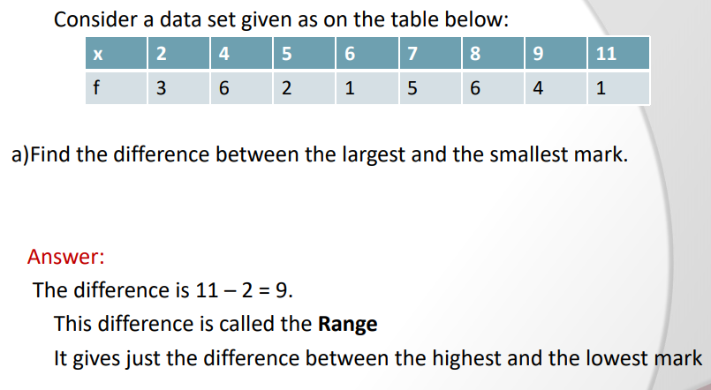
Range

Slide 59
Range for grouped data
The range of a sample of data organized in a frequency distribution is computed by the following formula:
Range = upper limit of the last class - lower limit of the first class

Slide 60
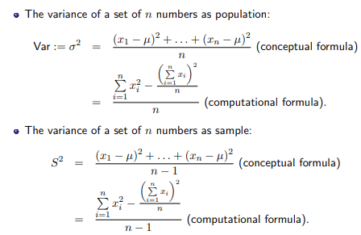
Measures Data Dispersion: Variance and Standard Deviation
Standard deviation s (or σ) is the square root of variance s² ⁽or σ²⁾

Slide 61
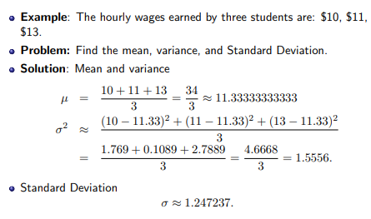
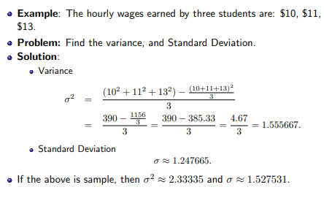
Conceptual and Computational formula

Slide 62
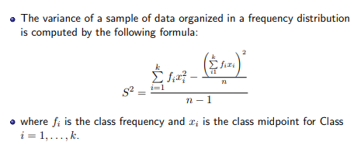
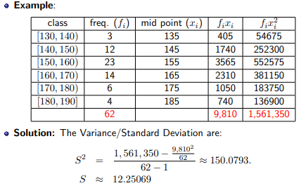
Variance/Standard Deviation for Grouped Data

Slide 63
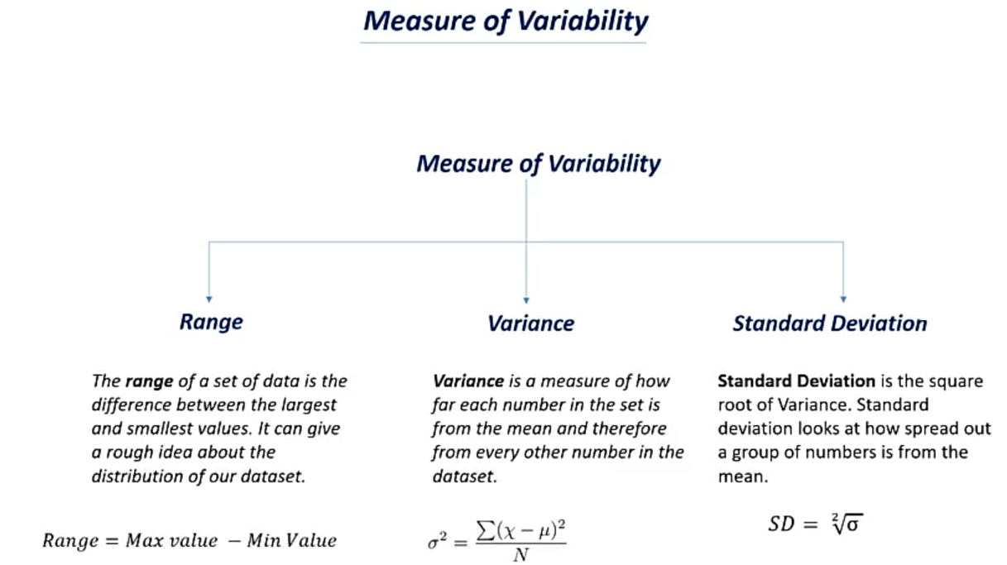

Slide 64
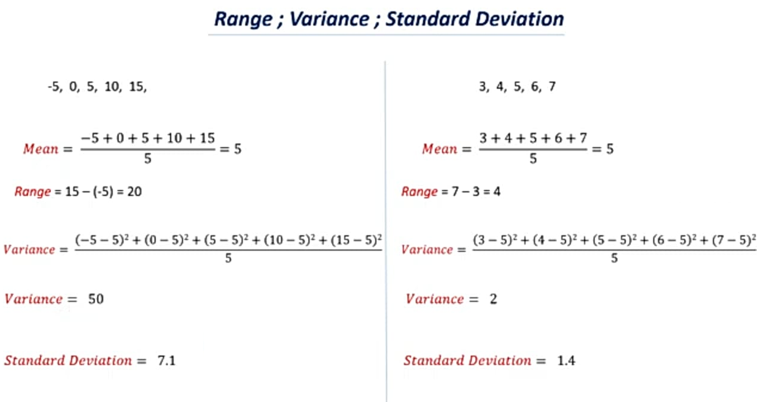

Slide 65
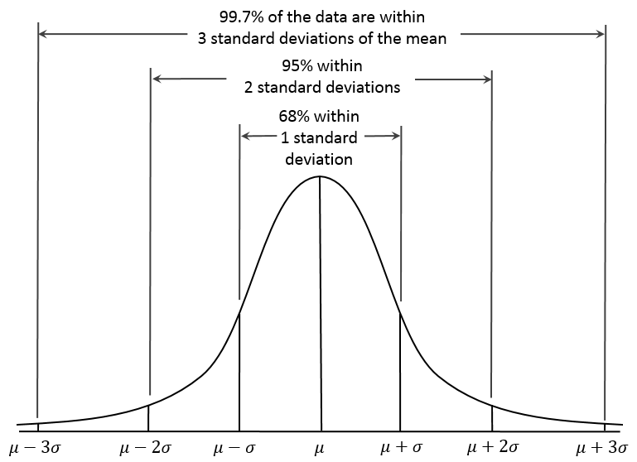
Properties of Normal Distribution Curve
← — ————Represent data dispersion, spread — ————→
Represent central tendency

Slide 66
Properties of Normal Distribution Curve
The normal (distribution) curve
From μ–σ to μ+σ: contains about 68% of the measurements (μ: mean, σ: standard deviation)
From μ–2σ to μ+2σ: contains about 95% of it
From μ–3σ to μ+3σ: contains about 99.7% of it

Slide 67
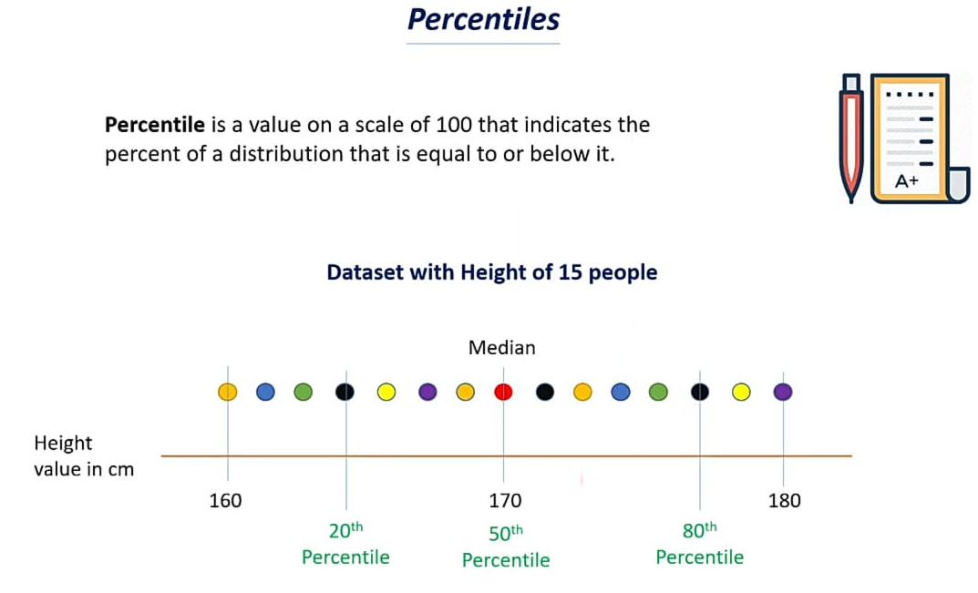

Slide 68
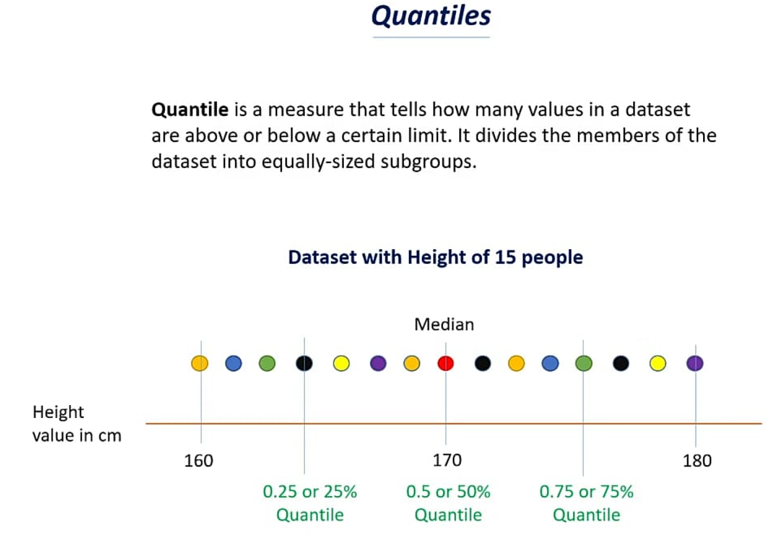

Slide 69
Quantile vs quartile
Quantile means one of the class of values of a variate which divides the members of a batch or sample into equal-sized subgroups of adjacent values or a probability distribution into distributions of equal probability,
whereas quartile means any of the three points that divide an ordered distribution into four parts, each containing a quarter of the population.

Slide 70
Graphic Displays of Basic Statistical Descriptions
Boxplot: graphic display of five-number summary
Histogram: x-axis are values, y-axis repres. frequencies
Quantile plot: each value x_{i} is paired with f_{i} indicating that approximately 100 f_{i} % of data are ≤ x_{i}
Quantile-quantile (q-q) plot: graphs the quantiles of one univariant distribution against the corresponding quantiles of another
Scatter plot: each pair of values is a pair of coordinates and plotted as points in the plane
Notes:
JH: Maybe we can remove Loess curve

Slide 71
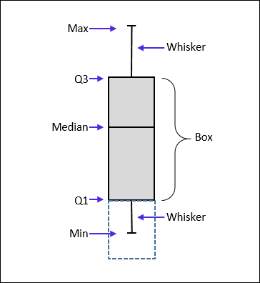
Measuring the Dispersion of Data: Quartiles & Boxplots
Quartiles: Q₁ (25th percentile), Q₃ (75th percentile)
Inter-quartile range: IQR = Q₃ – Q₁
Five number summary: min, Q₁, median, Q₃, max
Boxplot: Data is represented with a box
Q₁, Q₃, IQR: The ends of the box are at the first and third quartiles, i.e., the height of the box is IQR
Median (Q₂) is marked by a line within the box
Whiskers: two lines outside the box extended to Minimum and Maximum
Outliers: points beyond a specified outlier threshold, plotted individually
Outlier: usually, a value higher/lower than 1.5 x IQR

Slide 72
The 5 Number Summary
The five number summary is another name for the visual representation of the box and whisker plot.
The five number summary consist of :
The median ( 2nd quartile)
The 1st quartile
The 3rd quartile
The maximum value in a data set
The minimum value in a data set

Slide 73
Box Plots
Box and Whisker Diagrams.
Anatomy of a Box and Whisker Diagram.
Lower Quartile
Upper Quartile
Lowest Value
Median
Highest Value
Whisker
Box
Whisker
4
5
6
7
8
9
10
11
12

Slide 74

Graphing The Data
Notice, the Box includes the lower quartile, median, and upper quartile.
The Whiskers extend from the Box to the max and min.

Slide 75

Measuring the Dispersion of Data: Quartiles & Boxplots
A sample of 10 boxes of raisins has these weights (in grams):
25, 28, 29, 29, 30, 34, 35, 35, 37, 38
Make a box plot of the data.
Step 1: Order the data from smallest to largest.
Our data is already in order. 25, 28, 29, 29, 30, 34, 35, 35, 37, 38
Step 2
Find the median.
The median is the mean of the middle two numbers:
30+34/2 = 32 median=32
Step 3: Find the quartiles.
The first quartile is the median of the data points to the left of the median. Q1=29
The third quartile is the median of the data points to the right of the median. Q3=35
Step 4: Complete the five-number summary by finding the min and the max.
The min is the smallest data point, which is 25.
The max is the largest data point, which is 38.
The five-number summary is 25, 29, 32, 35, 38.

Slide 76

Measuring the Dispersion of Data: Quartiles & Boxplots
A sample of 10 boxes of raisins has these weights (in grams):
25, 28, 29, 29, 30, 34, 35, 35, 37, 38
Make a box plot of the data.
About 75%, percent of the boxes of raisins weighed more than 29 grams.

Slide 77
Constructing a box and whisker plot : Example 2
Step 1 - take the set of numbers given…34, 18, 100, 27, 54, 52, 93, 59, 61, 87, 68, 85, 78, 82, 91
Place the numbers in order from least to greatest:18, 27, 34, 52, 54, 59, 61, 68, 78, 82, 85, 87, 91, 93, 100
Step 2 - Find the median. Remember, the median is the middle value in a data set. 18, 27, 34, 52, 54, 59, 61, 68, 78, 82, 85, 87, 91, 93, 100
68 is the median of this data set.
Step 3 – Find the lower quartile. The lower quartile is the median of the data set to the left of 68. (18, 27, 34, 52, 54, 59, 61,) 68, 78, 82, 85, 87, 91, 93, 100
52 is the lower quartile
Step 4 – Find the upper quartile.The upper quartile is the median of the data set to the right of 68. 18, 27, 34, 52, 54, 59, 61, 68, (78, 82, 85, 87, 91, 93, 100)
87 is the upper quartile
Step 5 – Find the maximum and minimum values in the set. The maximum is the greatest value in the data set. The minimum is the least value in the data set. 18, 27, 34, 52, 54, 59, 61, 68, 78, 82, 85, 87, 91, 93, 100. 18 is the minimum and 100 is the maximum.

Slide 78
Constructing a box and whisker plot : Example 2
Step 6 – Find the inter-quartile range (IQR).
The inter-quartile (IQR) range is the difference between the upper and lower quartiles.
Upper Quartile = 87
Lower Quartile = 52
87 – 52 = 35
35 = IQR
Organize the 5 number summary
Median – 68
Lower Quartile – 52
Upper Quartile – 87
Max – 100
Min – 18
Draw the Boxplot now !!!

Slide 79
Constructing a box and whisker plot : Example 3
2, 4, 5, 6, 7 ,8, 9, 11, 19, 20
Median = 7.5
Lower Quartile = 5
Upper Quartile = 11
Upper Extreme = 20
Lower Extreme = 2
Draw the Boxplot now !!!
Is the data skewed???

Slide 80

Interpreting the Box Plot:

Slide 81
Interpreting the Box Plot:
Symmetric: If a box and whisker plot is symmetric, the median is equidistant from the minimum and the maximum.
Negatively Skewed: If a box and whisker plot is negatively skewed, the distance from the median to the minimum is greater than the distance from the median to the maximum.
Positively Skewed: If a box and whisker plot is positively skewed, the distance from the median to the maximum is greater than the distance from the median to the minimum.

Slide 82
You should include the following in your interpretation:
Range or spread of the data and what it means to your graph
Quartiles—compare them. What are they telling you about the data?
Median- this is an important part of the graph, and should be an important part of the interpretation.
Percentages should be used to interpret the data, where relevant.

Slide 83
Analyzing The Graph
The data values found inside the box represent the middle half ( 50%) of the data.
The line segment inside the box represents the median

Slide 84
Compute 5 Number Summary and outlier detection
Data: 3, 7, 11, 11, 15, 21, 23, 39, 41, 45, 50, 61, 87, 99, 220
Median - 39
Lower Quartile - 11
Upper Quartile - 61
Max - 220
Min – 3
Lower end of data possible = Q1- (1.5 * IQR) = 11 – ( 1.5 * 50) = -64
Upper end of data possible = Q3 + (1.5 * IQR) = 61 + (1.5 * 50) = 136
Outlier is the data value 220
Draw the Boxplot now !!!
Is the data skewed???

Slide 85
Practice Questions: Quartiles & Boxplots
The five-number summary for the number of accounts managed by each sales manager at
ABC Inc. is shown in the following table.
The five-number summary suggests that about 50%, percent of sales managers at ABC Inc. manage fewer than what number of accounts?
Min | Q1 | Median | Q3 | Max
35 | 45 | 50 | 65 | 85
Draw the Boxplot now !!!

Slide 86
Practice Questions: Quartiles & Boxplots
Jason saves a portion of his salary from his part-time job in the hope of buying a used car. He recorded the number of dollars he was able to save over the past 15 weeks. Dollars saved: 19, 12, 9, 7, 17, 10, 6, 18, 9, 14, 19, 8, 5, 17, 9
Draw box plot
Draw the Boxplot now !!!
Is the data skewed???

Slide 87

Practice Questions: Quartiles & Boxplots
The distribution of daily average wind speed on an island over a period of 120 days is displayed on this box-and-whisker diagram.
(a) Write down the median wind speed.
(b) Write down the minimum wind speed.
(c) Find the interquartile range.
(d) Write down the number of days the wind speed was between 20 kmh⁻¹ and 51 kmh⁻¹.
(e) Write down the number of days the wind speed was between 9 kmh⁻¹ and 68 kmh⁻¹.
Draw the Boxplot now !!!
Is the data skewed???

Slide 88

Visualization of Data Dispersion: 3-D Boxplots

Slide 89

Histogram Analysis
Histogram: Graph display of tabulated frequencies, shown as bars
Differences between histograms and bar charts
Histograms are used to show distributions of variables while bar charts are used to compare variables
Histograms plot binned quantitative data while bar charts plot categorical data
Bars can be reordered in bar charts but not in histograms
Differs from a bar chart in that it is the area of the bar that denotes the value, not the height as in bar charts, a crucial distinction when the categories are not of uniform width
Histogram
Bar chart
Notes:
JH: A better and BASIC histogram figure --- because this one overlaps with a later one!

Slide 90
Histograms Often Tell More than Boxplots
The two histograms shown in the left may have the same boxplot representation
The same values for: min, Q1, median, Q3, max
But they have rather different data distributions

Slide 91

Quantile Plot
Displays all of the data (allowing the user to assess both the overall behavior and unusual occurrences)
Plots quantile information
For a data x_{i} data sorted in increasing order, f_{i} indicates that approximately 100 f_{i}% of the data are below or equal to the value x_{i}

Slide 92

Quantile-Quantile (Q-Q) Plot
Graphs the quantiles of one univariate distribution against the corresponding quantiles of another
View: Is there is a shift in going from one distribution to another?
Example shows unit price of items sold at Branch 1 vs. Branch 2 for each quantile. Unit prices of items sold at Branch 1 tend to be lower than those at Branch 2.
Notes:
Note: We need to label the dark plotted points as Q1, Median, Q3 – that would help in understanding this graph.
Tell audience: There is a shift in distribution of branch 1 WRT branch 2 in that the unit prices of items sold at branch 1 tend to be lower than those at branch 2.

Slide 93
Exploring Bivariate Data
Notes:
30

Slide 94

Scatter plot
A scatter plot - effective graphical methods for determining if there appears to be a relationship, pattern, or trend between two numeric attributes.
Provides a first look at bivariate data to see clusters of points, outliers, etc
Each pair of values is treated as a pair of coordinates and plotted as points in the plane

Slide 95


Scatter plot
Provides a first look at bivariate data to see clusters of points, outliers, etc.
Each pair of values is treated as a pair of coordinates and plotted as points in the plane
Notes:
Need a better and more MEANINGFUL scatter plot! -JH

Slide 96
Positively and Negatively Correlated Data
The left half fragment is positively correlated
The right half is negative correlated

Slide 97



Uncorrelated Data

